Slide 1
Controlling Multiple Omnimagnet
Mohamed Ghori 06.06.2016

Slide 2
Outline
Background
Objectives
Methodology
Results
Future work

Slide 3
Background

Slide 4
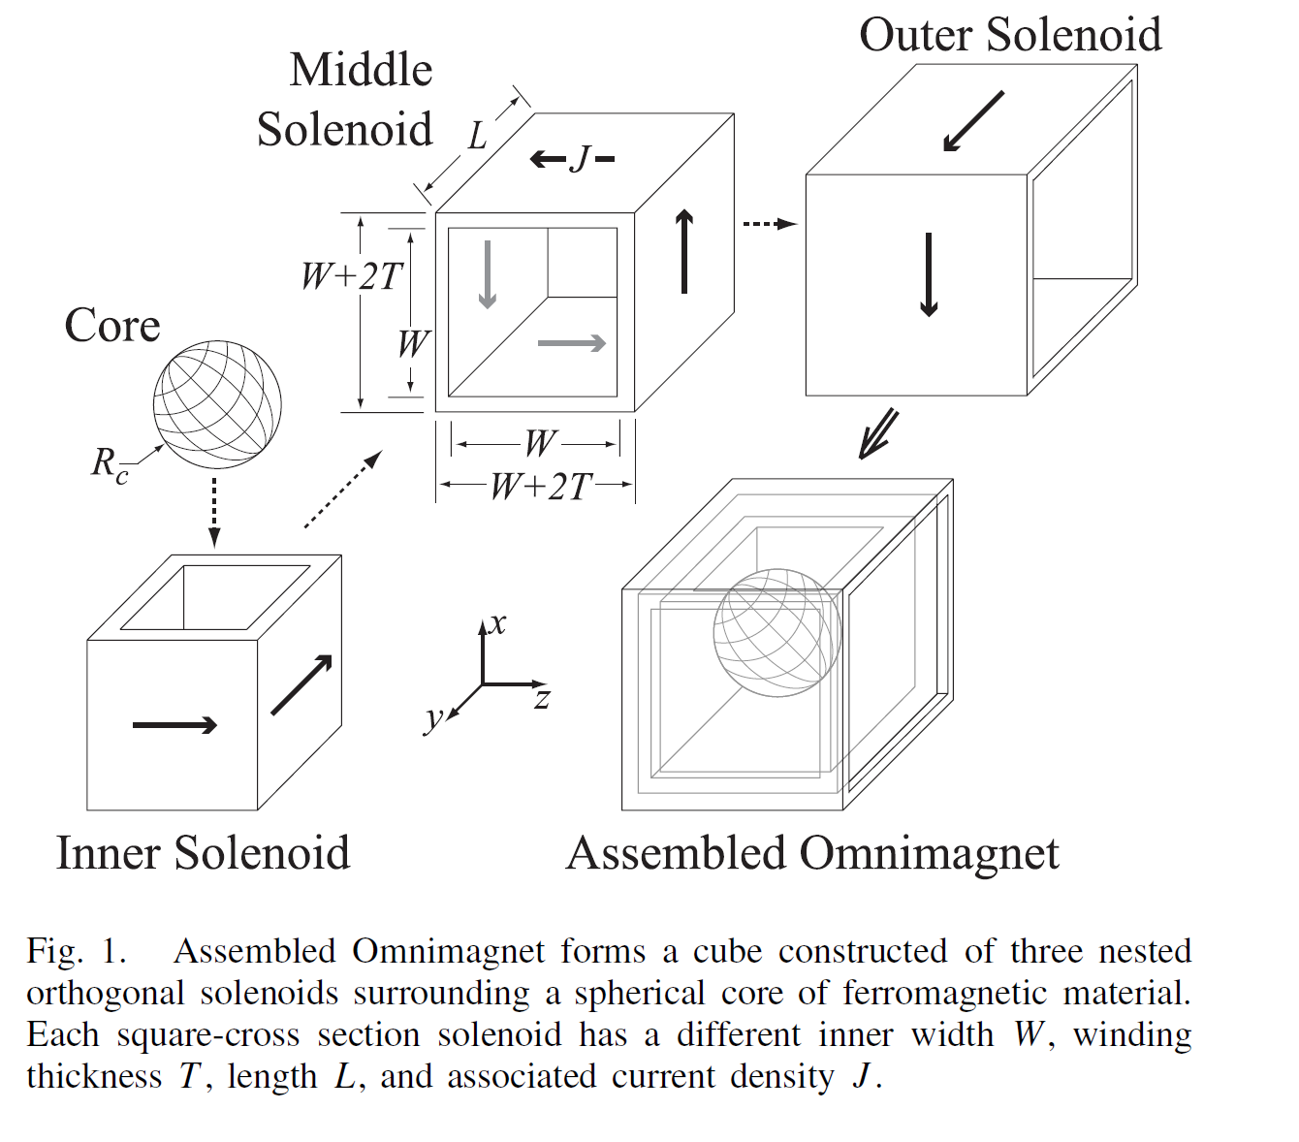
Omnimagnet
Notes:
Omnimagnet: Consists of 3 consecutively orthogonal solenoids with a spherical ferromagnetic core
> The Omnimagnet can produce an arbitrary magnetic field

Slide 5
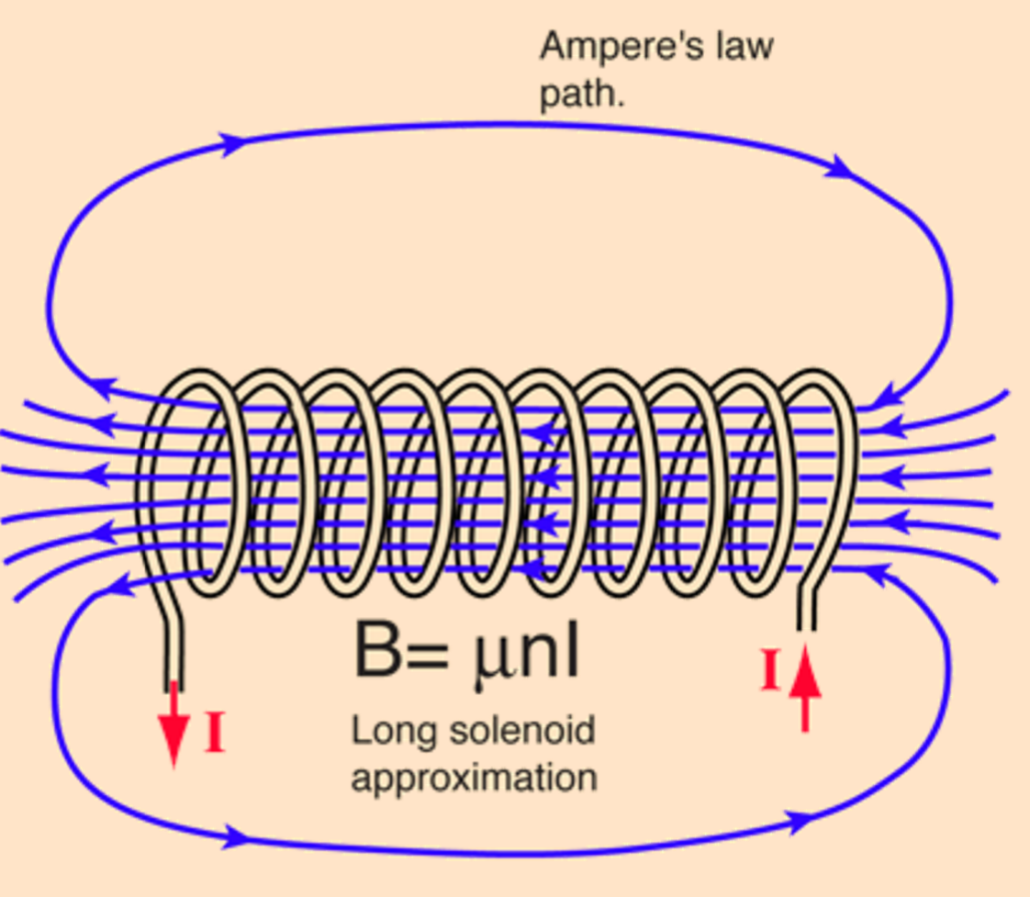
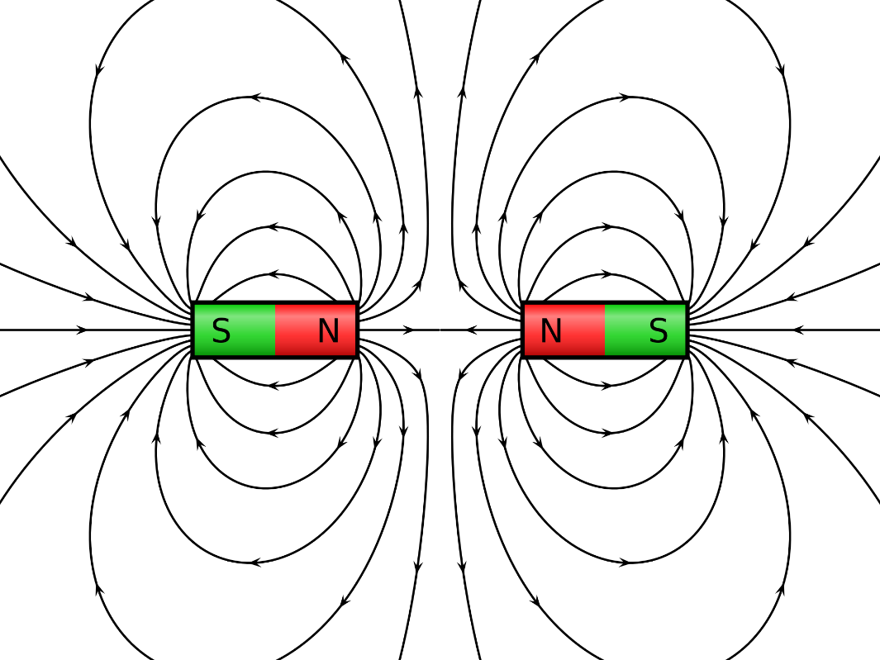
Magnetic Dipole Field
SOLENOID
Dipole Field
Notes:
Solenoid is similar to a bar magnet in its magnetic field

Slide 6
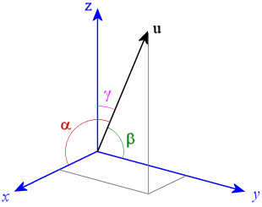
Magnetic Field Rotatoin
Magnetic Field Lines will Rotate
Alpha
Beta
Gama
Magnetic Field Lines
Assumed Parallel
Notes:
The Magnetic Field is assumed to be a series of parallel lines at a far distance from the Omnimagnet
These lines have an orientation in 3D space

Slide 7
Methodology

Slide 8
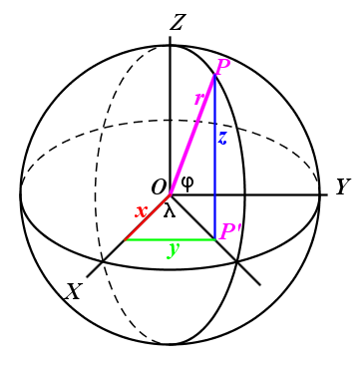
Rotating Ball with Magnetic Field
Ball Frame Rotates with Magnetic Field
Notes:
The Magnet Ball is always assumed to be at steady state: The orientation is equivalent of the Magnetic Field and the Magnet Ball (Assuming North is along the Ball Z-axis)
This assumption is used to manipulate the Magnet Ball

Slide 9
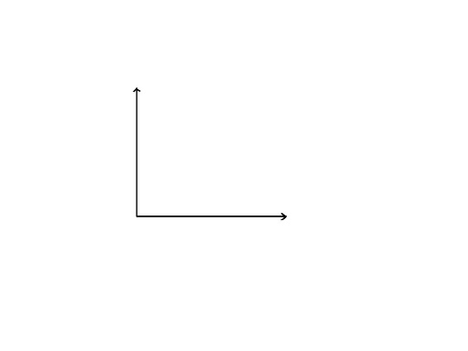
Trajectory
y
W
x
L
Notes:
A rectangular trajectory is chosen
For this trajectory an arbitrary time of completion is chosen and a desired average velocity is calculated
Using this velocity as a step size we acquire xdes and ydes

Slide 10

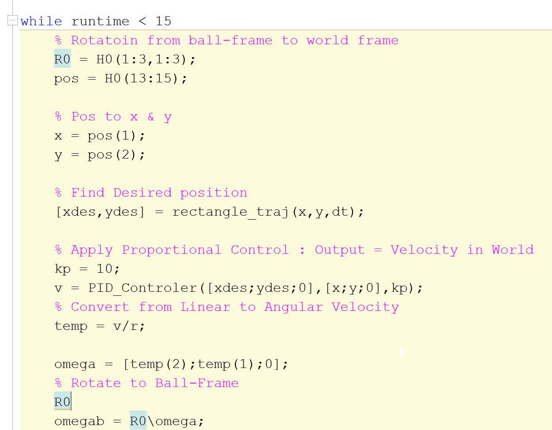
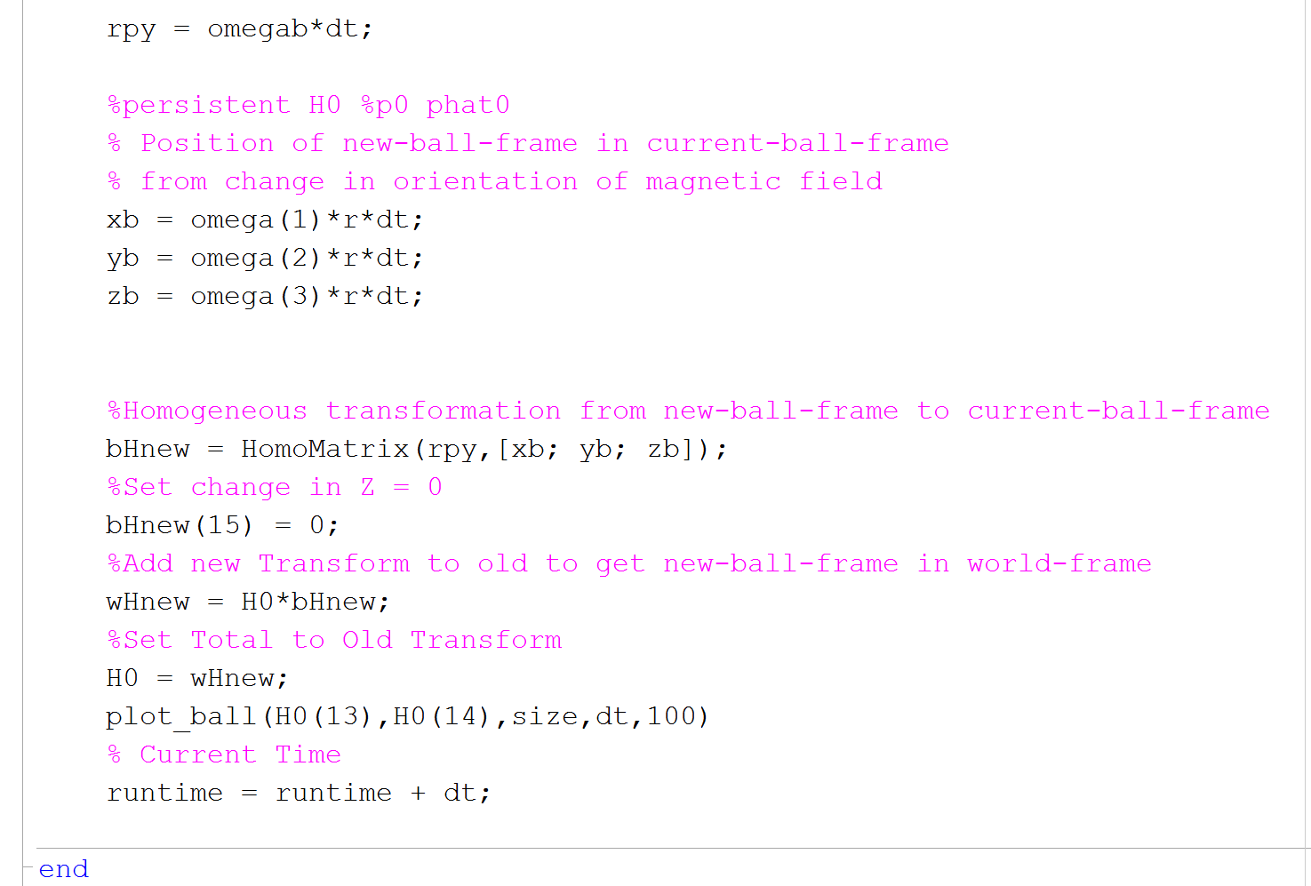
Controller
Notes:
Modelled as a Multi-directional Planar Cart
A simple position based Proportional controller is implemented to keep the Magnet Ball on the desired trajectory
The controller output (velocity) is used to calculated the commanded Linear Velocity
The linear velocity is converted to angular velocity in the world frame
Angular-Velocity vectors are transformed to Current-Ball-Frame

Slide 11
Results

Slide 12
Steps
Take current position and rotation
Find Closest desired position to current position
Run through P controller
Convert Linear to Rotation Velocity
Transform Angular vectors to Ball-frame
Find New H matrix
Repeat>>

Slide 13
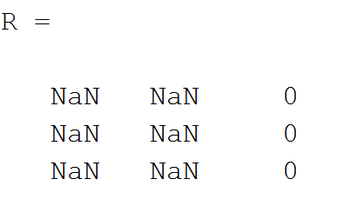
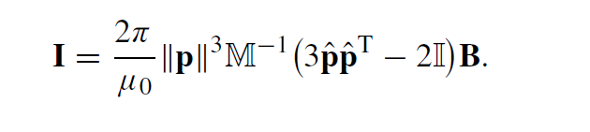
Problems
Rotation matrix becomes Singular
Z-axis of ball(axis along magnetic field) is included in simulation
Magnetic field Vector Not Implemented
Control in Angle terms not Magnetic Field terms
Notes:
Singularity in the way I am simulating the Ball kinematics
In terms of Angular Velocity not Current/Magnetic Field (Using inverse of dipole field equation)
Remove Z-axis Degree of freedom

Slide 14
Stuff I’ve tried
Changing to Quaternion
Still Singular terms arise

Slide 15
Future 06.06.2016

Slide 16
Future Goals 06.06.2016
Fix SINGULARITY & complete model of SPHERE CONTROL
Convert from ANGULAR VELOCITY to CHANGING MAGNETIC FIELD
Make code more robust to include ANY STARTING ORIENTATION
Play code to ARBRITRARY STARTING ORIENTATION

